Slide 2
Choosing a New Platform for Records or Document Management
Some Basics to Consider
And Some Things to Avoid

Slide 3
Raoul Miller
Director, Content Advisory & Strategy
TEAM IM
raoul.miller@teamim.com
@ECM_Raoul

Slide 4


TEAM IM
Content and unstructured data specialists since 1999
Oracle, M-Files, Microsoft, Elasticsearch, HelloSign, Frevvo, ABBYY, Smartlogic partners
Operate in US, Canada, Australia and New Zealand
Advisory and Strategy practice is one part of what we do.
© Raoul Miller

Slide 5

High Speed Agenda
The changing market
Focus on your key needs
Working in your existing ecosystem
Avoid buying too much
Evaluation
(BigStock Photo)

Slide 6
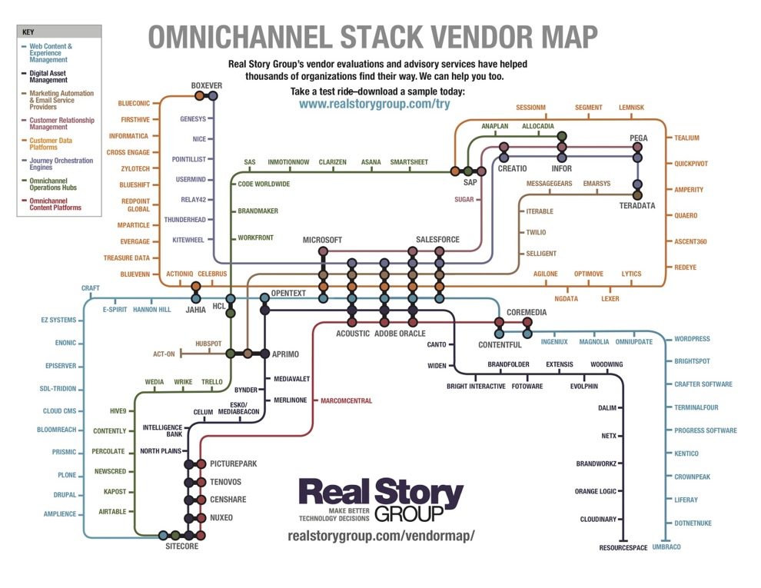
The Changing Market
Marketplace has consolidated
New players
Complex landscape
Legacy vs. startup
Cloud vs. on-prem

Slide 7
Focus on Your Key Needs
You have to know what you *need*
Wants are not needs
Keep it simple
18-24 month timeframe
Don’t be oversold
(© Raoul Miller)

Slide 8
Working in Your Existing Ecosystem
What is your existing tech footprint?
What is your current level of expertise?
What are you using already?
What do you need to integrate with?
Where will you deploy it?
(© Raoul Miller)

Slide 9
Avoid Buying Too Much
Stay focused on business requirements
Salespeople are well-trained
Be prepared in advance
Plan to upgrade and scale up
(© Raoul Miller)

Slide 10

Evaluation
RFPs don’t work
Pilot / trial
Focus on usability
Involve your users
Don’t let IT drive the process
(© Raoul Miller)

Slide 11
Takeaways
Understand the market
Identify and document *your* key needs
Plan for integration
Don’t buy too much
Focus on usability during evaluation
(© Raoul Miller)

Slide 12
Questions?
Raoul Miller
Director, Content Advisory and Strategy
TEAM IM
raoul.miller@teamim.com
@ECM_Raoul (Twitter)

